Slide 1

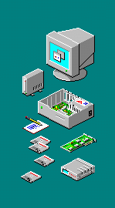

Report (Laporan)

Slide 2
Jaspersoft Studio
• Menggunakan Jaspersoft Studio, Anda dapat mengakses berbagai jenis sumber data, termasuk data besar, CSV, Hibernate, Jaspersoft Domain, JavaBeans, JDBC, JSON, NoSQL, Tautan Informasi TIBCO Spotfire®, XML, atau sumber data kustom Anda sendiri

Slide 3
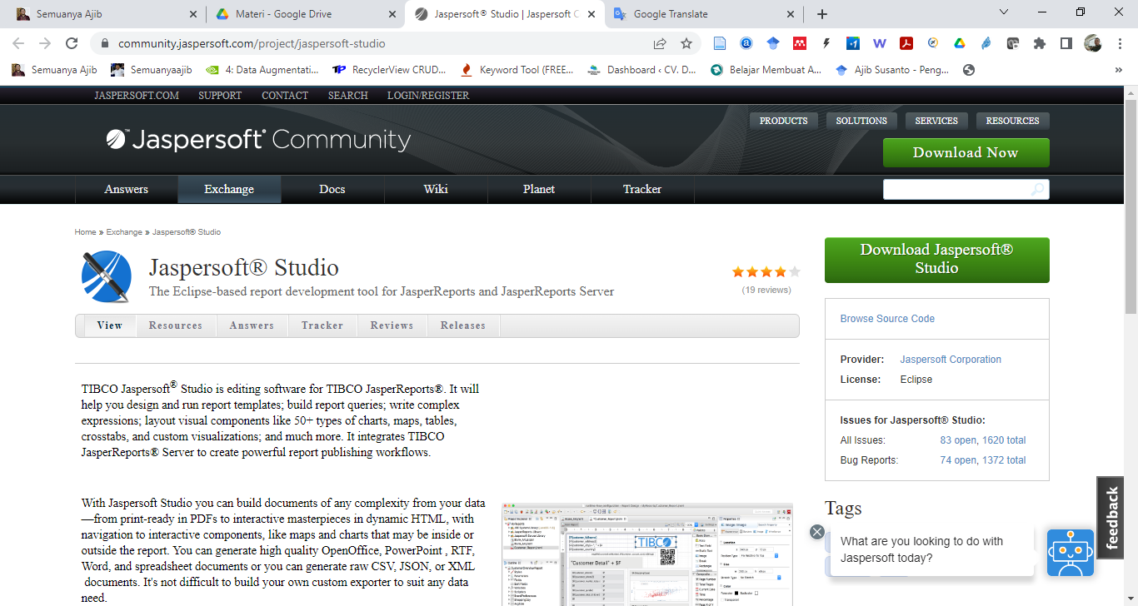
Jaspersoft Studio
• Download Jasper di : https://community.jaspersoft.com/project/jaspersoft-studio

Slide 4
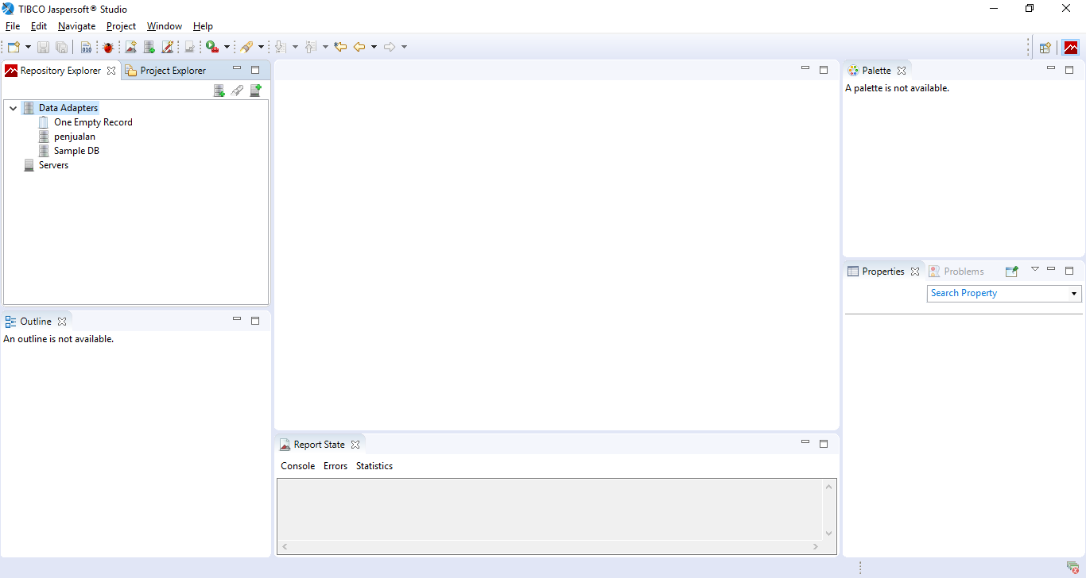
Jaspersoft Studio
• Install
• Jalankan TIBCO Jaspersoft Studio

Slide 5
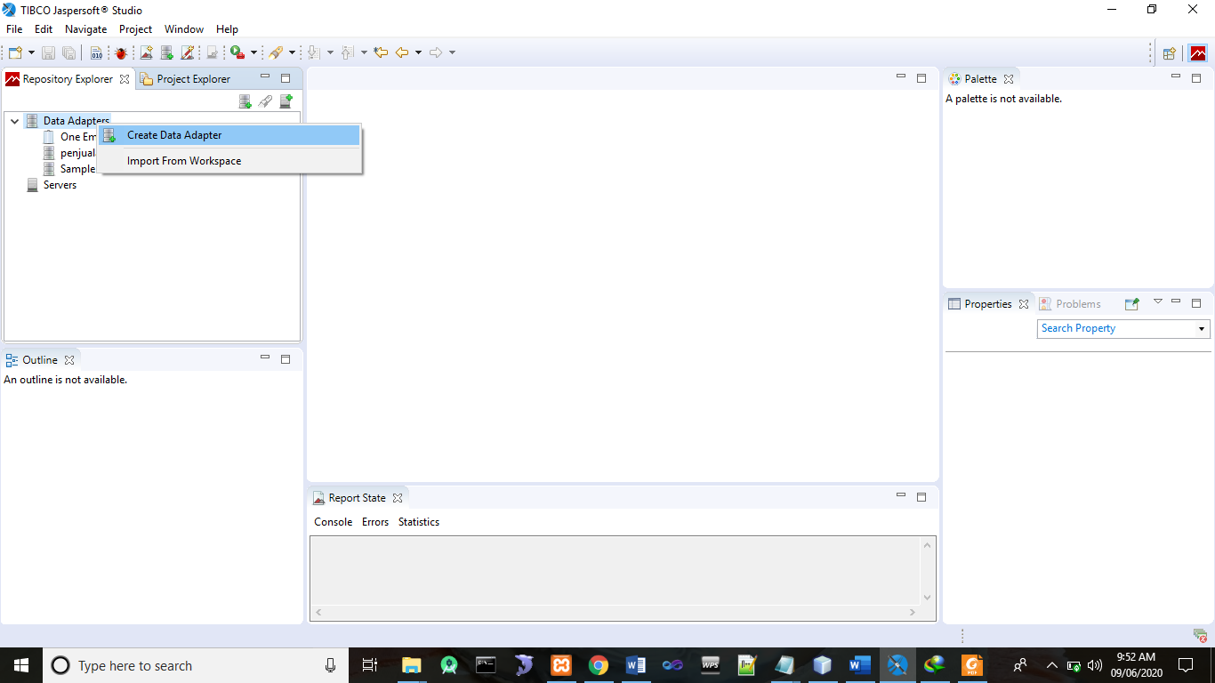
Jaspersoft Studio
Buat Data Adapater :
Klik kanan data Adapter -> Create Data Adapter

Slide 6
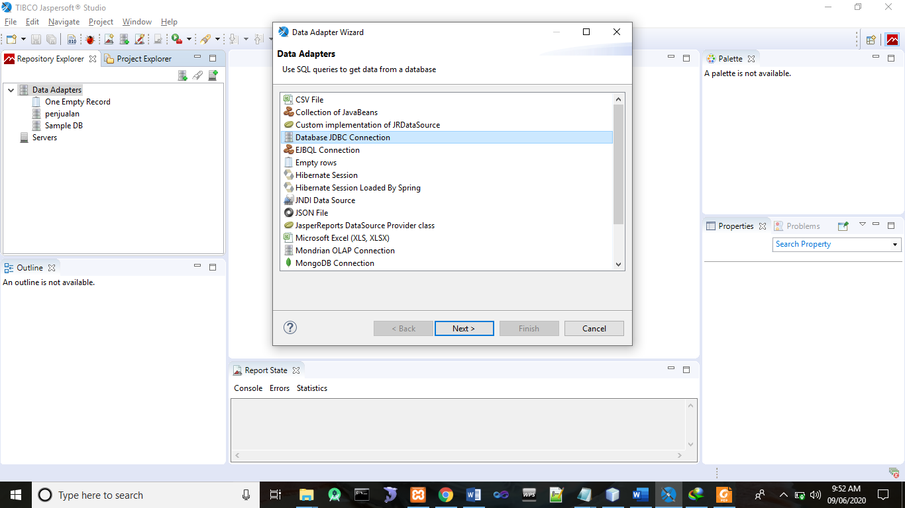
Jaspersoft Studio
Pilih Database JDBC Connection

Slide 7
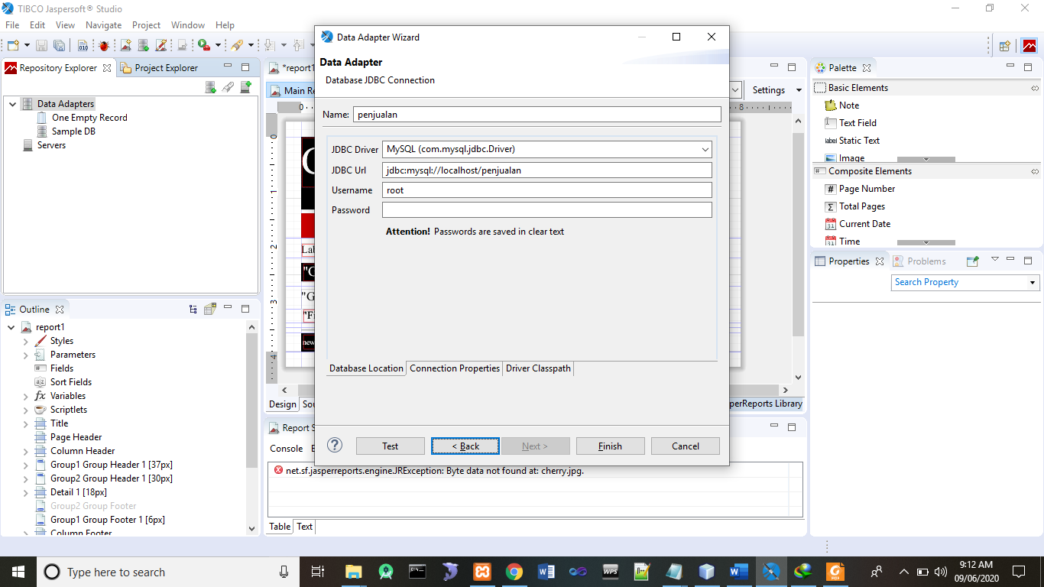
Jaspersoft Studio
Buat konfigurasi :
Name : penjualan
JDBC Driver : pilih MySQL
JDBC URL : jdbc:mysql/localhost/penjualan
Username : root
Password :

Slide 8
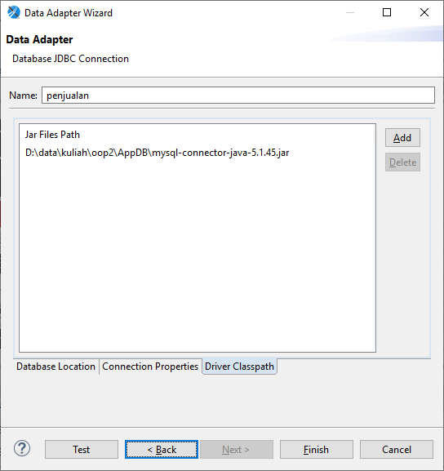
Jaspersoft Studio
Klik Driver Classpath→Add →File mysql-connector dapat di download di https://repo1.maven.org/maven2/mysql/mysql-connector-java/5.1.45/
https://repo1.maven.org/maven2/mysql/mysql-connector-java/8.0.17/
https://jar-download.com/artifacts/mysql/mysql-connector-java/8.0.17/source-code

Slide 9
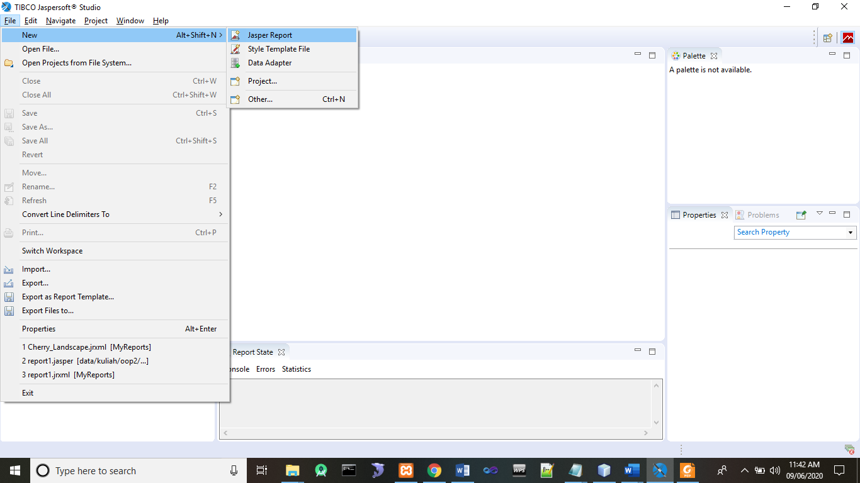
Jaspersoft Studio
Membuat Report baru, klik menu File→New→Jasper Report

Slide 10
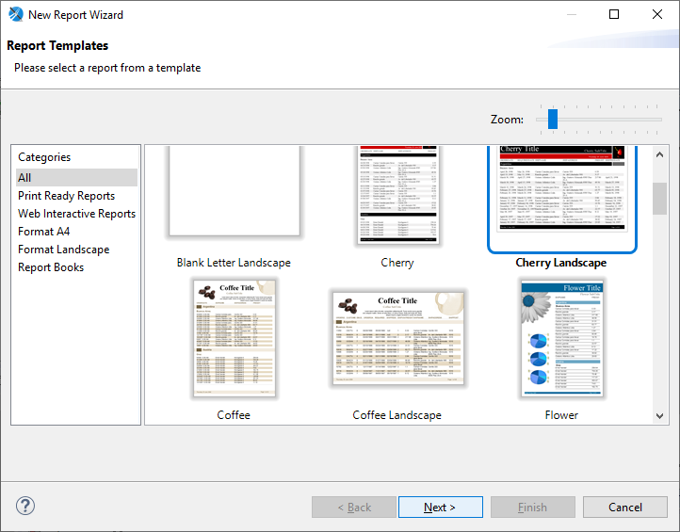
Jaspersoft Studio
Pilih Template, missal : Cherry Landscape

Slide 11
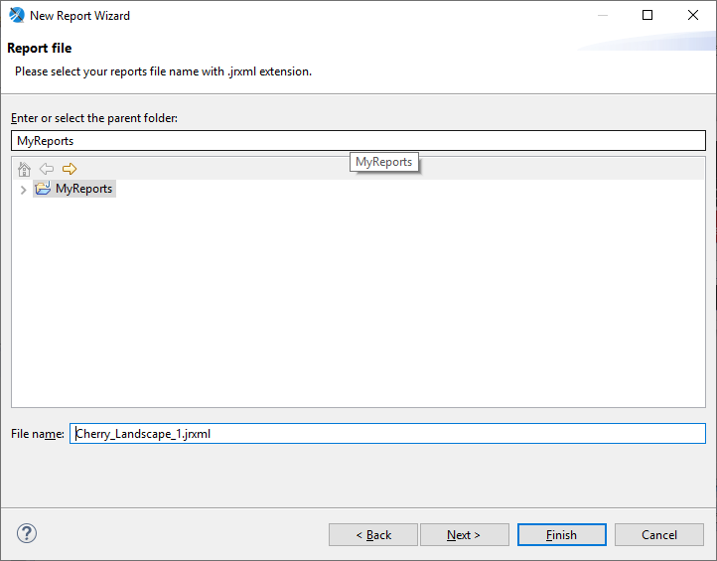
Jaspersoft Studio
Klik Next, pilih lokasi penyimpanan & nama file

Slide 12
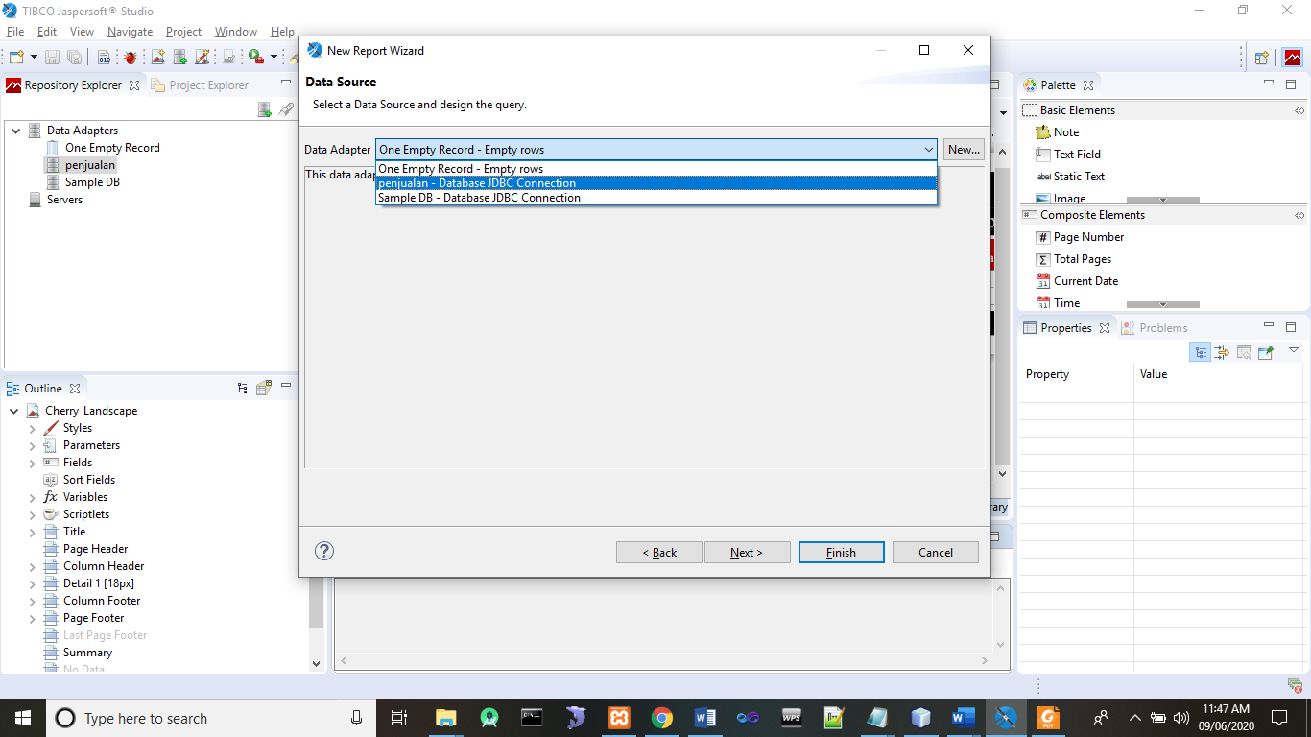
Jaspersoft Studio
Pilih koneksi yang sudah dibuat

Slide 13
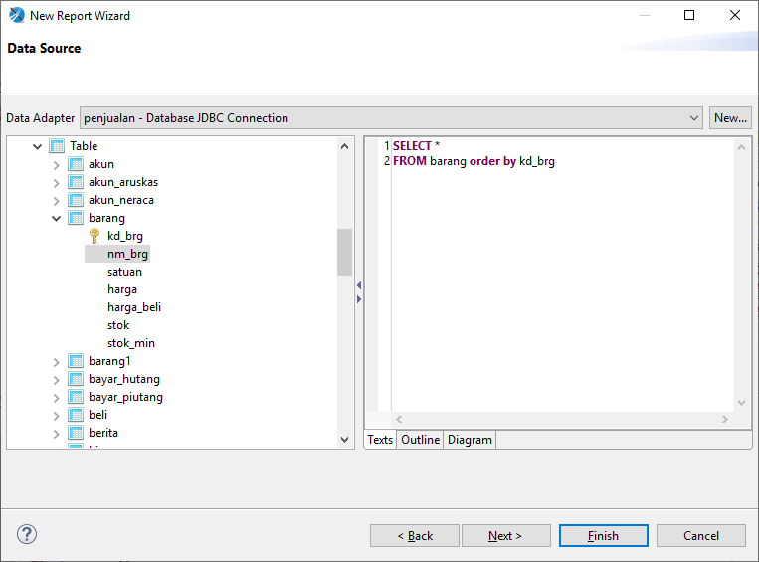
Jaspersoft Studio
Klik Finish, pilih database & tabel yang dibuat laporan, isikan query di area sebelah kanan di tabs Texts.

Slide 14
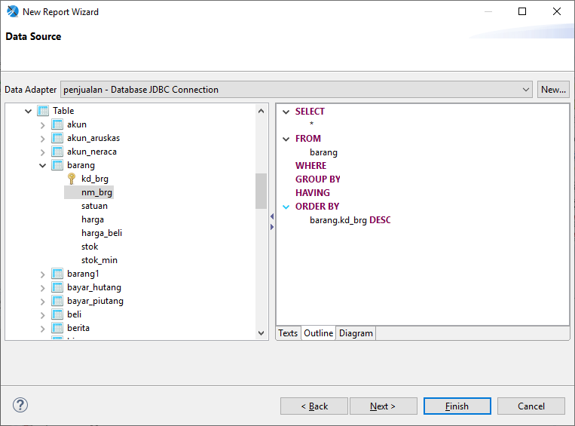
Jaspersoft Studio
Klik Tabs Outline :

Slide 15
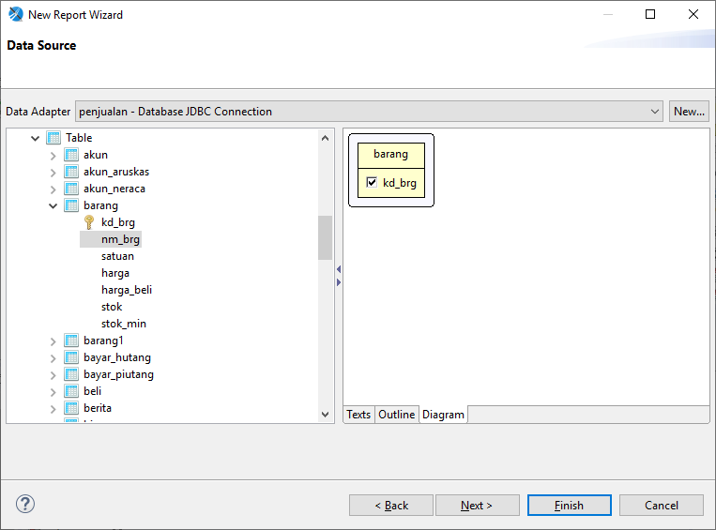
Jaspersoft Studio
Klik Diagram untuk melihat diagram

Slide 16
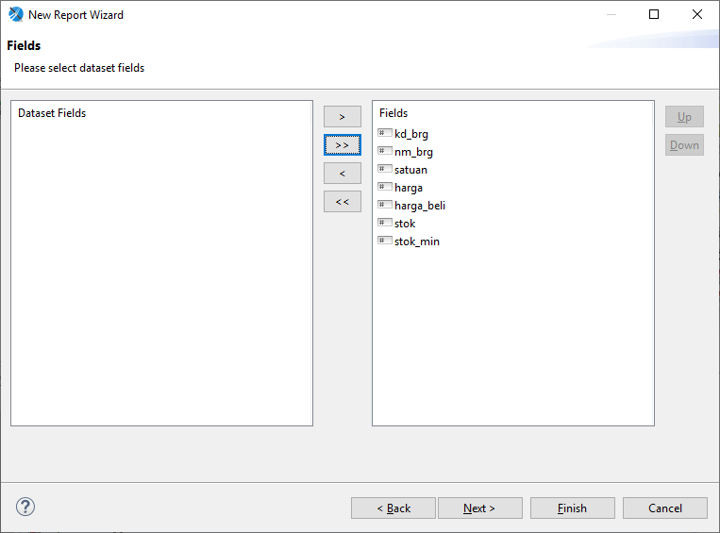
Jaspersoft Studio
Klik Next, pindahkan fields yang dibuat laporan

Slide 17
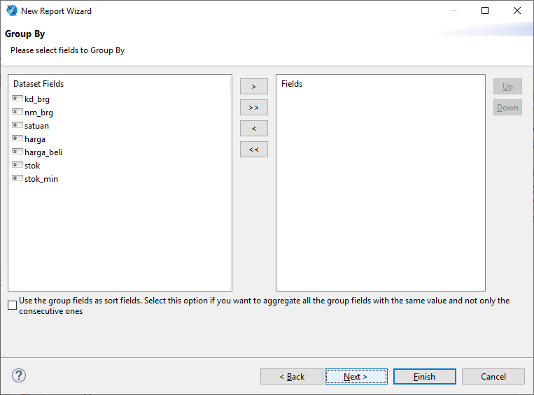
Jaspersoft Studio
Klik Next, pilih Group laporan, kosongkan jika tidak ada Grup.

Slide 18
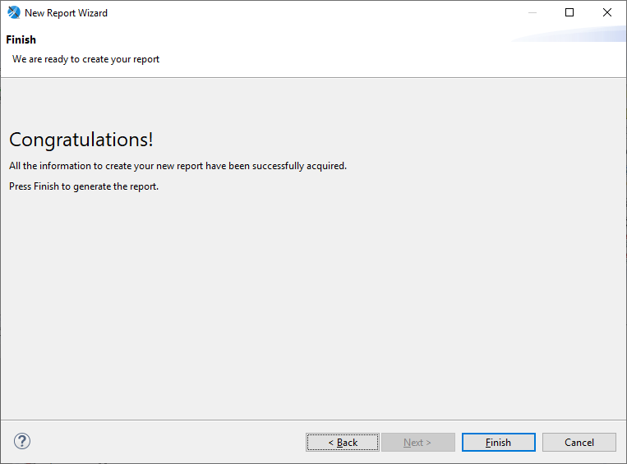
Jaspersoft Studio
Klik Next.

Slide 19
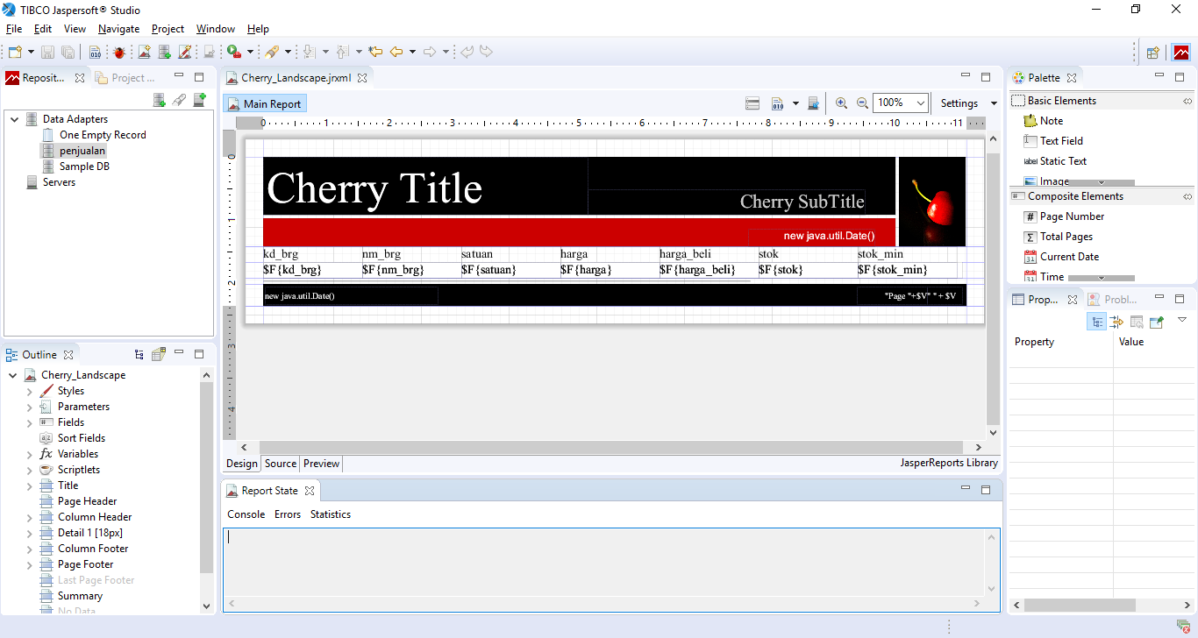
Jaspersoft Studio
Klik Finish, laporan sudah jadi

Slide 20
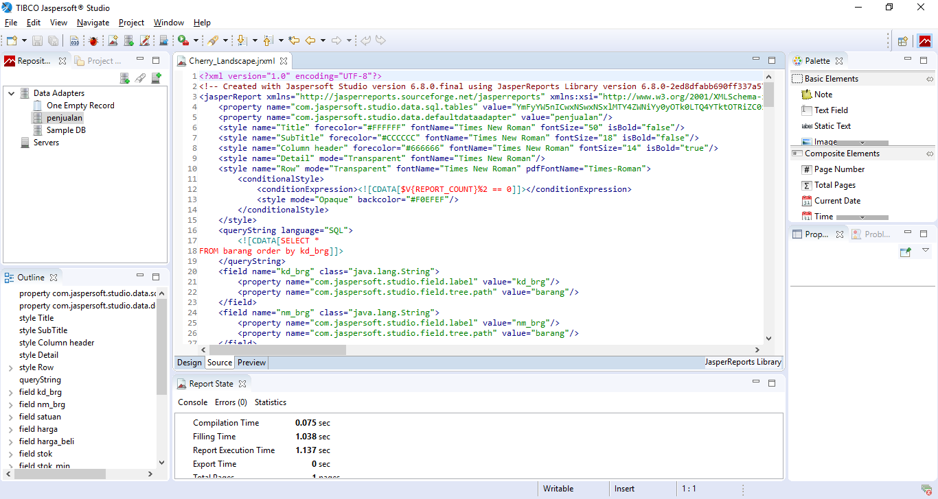
Jaspersoft Studio
Klik Tab Source untuk melihat Code XML nya

Slide 21
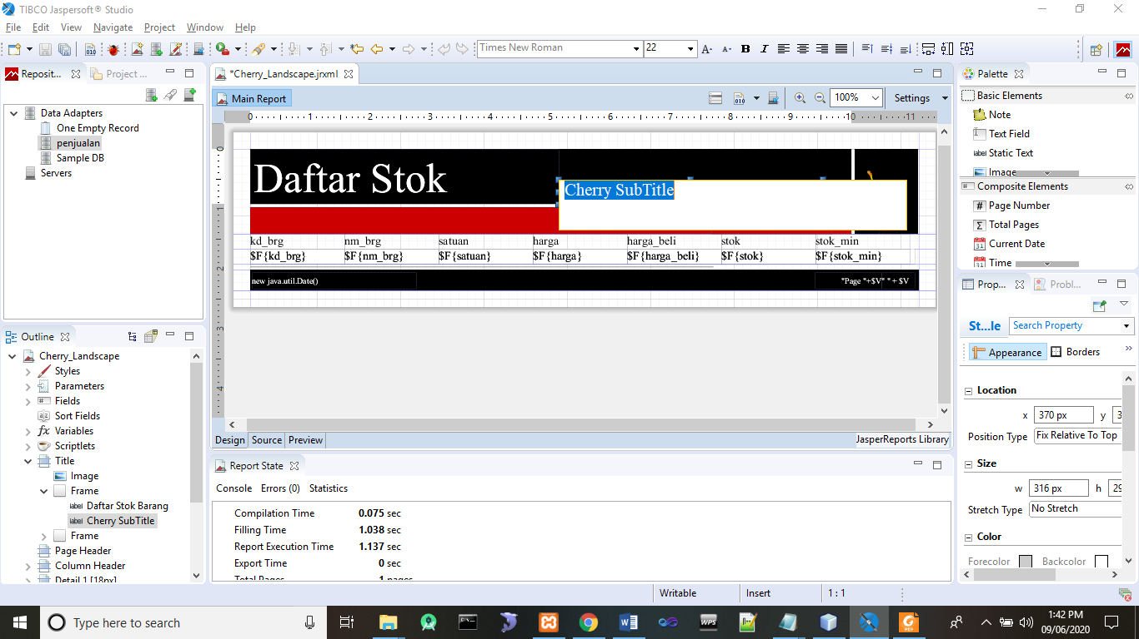
Jaspersoft Studio
Untuk mengedit Laporan di Tab Design, misalkan mengganti judul dll.

Slide 22
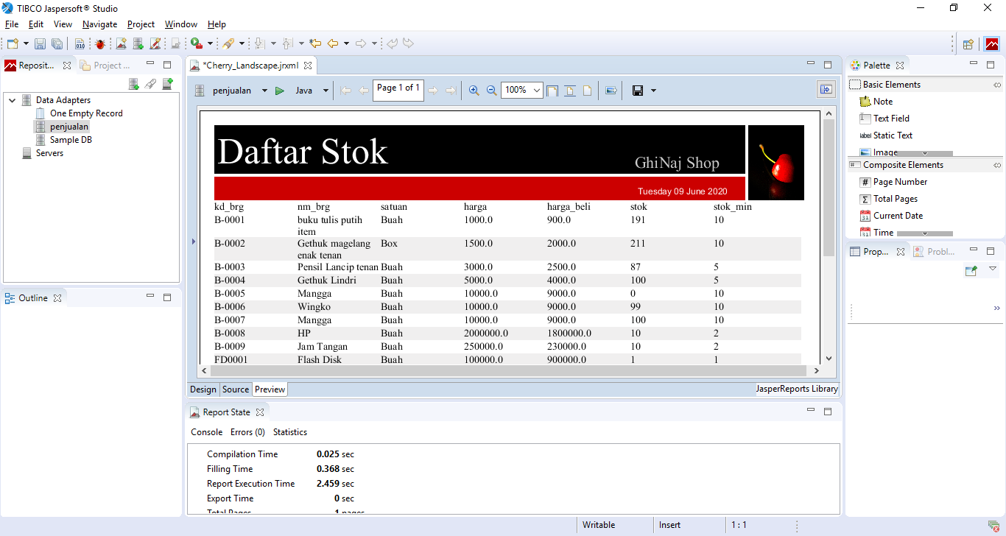
Jaspersoft Studio
Klik Tab Preview untuk melihat hasil.

Slide 23
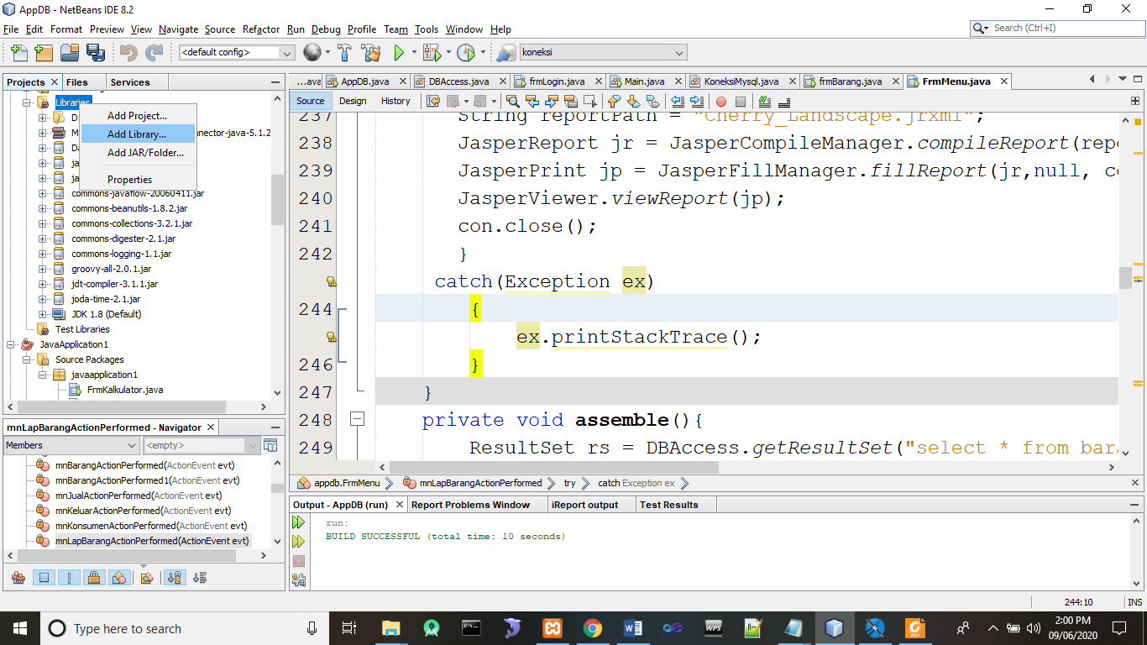
Memanggil Jasper Report di Java
Buka project anda, di Libraries klik kanan Add Library.

Slide 24
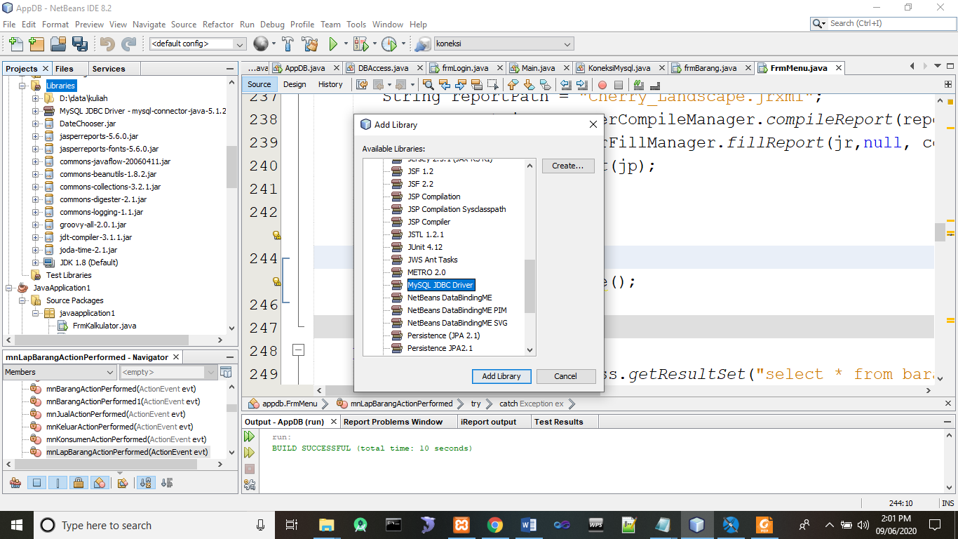
Memanggil Jasper Report di Java
Tambahkan MySQL JDBC Driver seperti gambar berikut :

Slide 25

Memanggil Jasper Report di Java
Tambahkan JAR file untuk menjalankan Jasper berikut ini :

Slide 26
Memanggil Jasper Report di Java
Add file JAR berikut :
commons-beanutils-1.8.2.jar
commons-collections-3.2.1.jar
commons-digester-2.1.jar
commons-javaflow-20060411.jar
commons-logging-1.1.jar
groovy-all-2.0.1.jar
jasperreports-5.6.0.jar
jasperreports-fonts-5.6.0.jar
jdt-compiler-3.1.1.jar
joda-time-2.1.jar

Slide 27
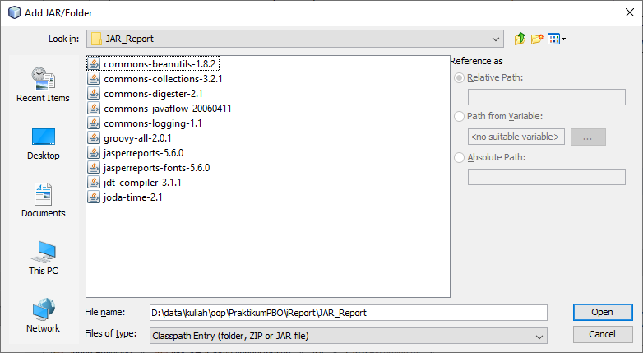
Memanggil Jasper Report di Java
Dapat di download di Drive atau https://drive.google.com/file/d/1YAGl5bJab5q8yGDBW2iPPZZJk9LJzntL/view?usp=sharing

Slide 28
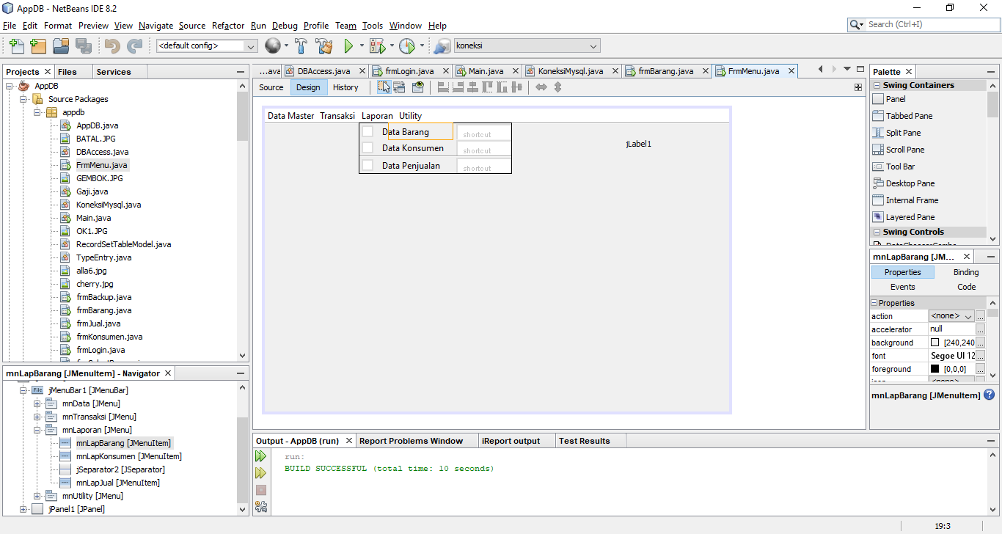
Memanggil Jasper Report di Java
Buat Menu seperti berikut :

Slide 29
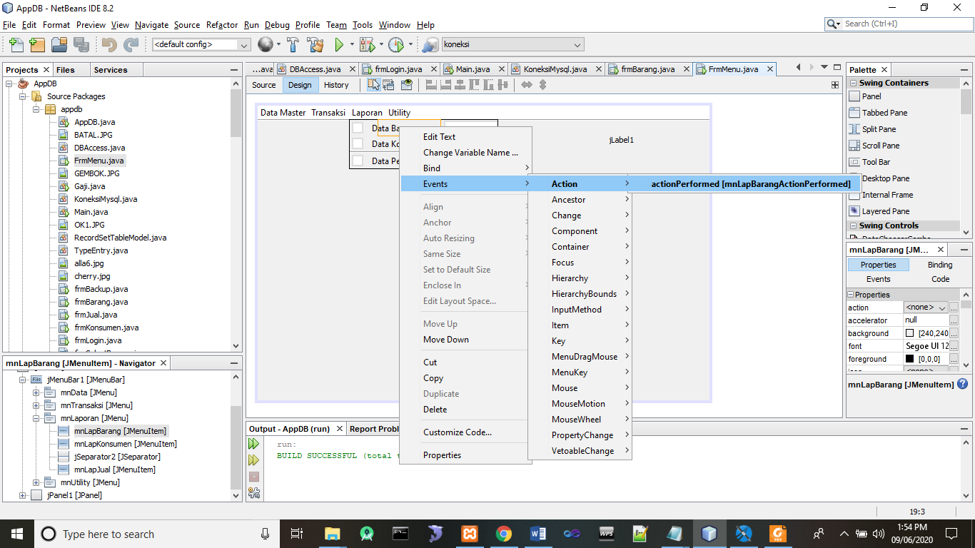
Memanggil Jasper Report di Java
Klik di menu Laporan→ Data Barang, klik kanan :

Slide 30
Memanggil Jasper Report di Java
Tambahkan code berikut :
private void mnLapBarangActionPerformed(java.awt.event.ActionEvent evt) {
try{
Class.forName("com.mysql.jdbc.Driver");
Connection con = DriverManager.getConnection("jdbc:mysql://localhost:3306/penjualan","root","");
String reportPath = "Cherry_Landscape.jrxml";
JasperReport jr = JasperCompileManager.compileReport(reportPath);
JasperPrint jp = JasperFillManager.fillReport(jr,null, con);
JasperViewer.viewReport(jp);
con.close();
}
catch(Exception ex)
{
ex.printStackTrace();
}
}

Slide 31
Memanggil Jasper Report di Java
Tambahkan Code di bawah Package :
import net.sf.jasperreports.engine.JasperFillManager;
import net.sf.jasperreports.engine.JasperPrint;
import net.sf.jasperreports.engine.JasperReport;
import net.sf.jasperreports.engine.JasperCompileManager;
import net.sf.jasperreports.view.JasperViewer;

Slide 32
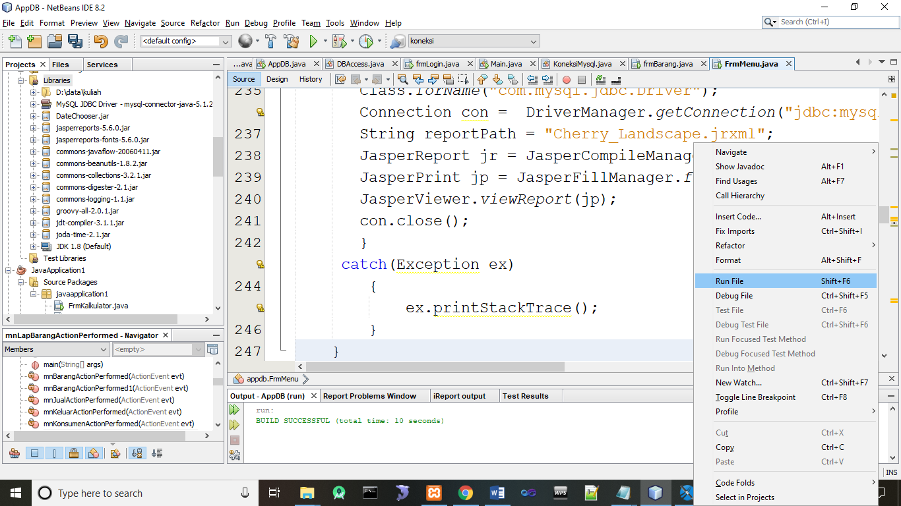
Memanggil Jasper Report di Java
Jalankan, klik kanan → Run File

Slide 33
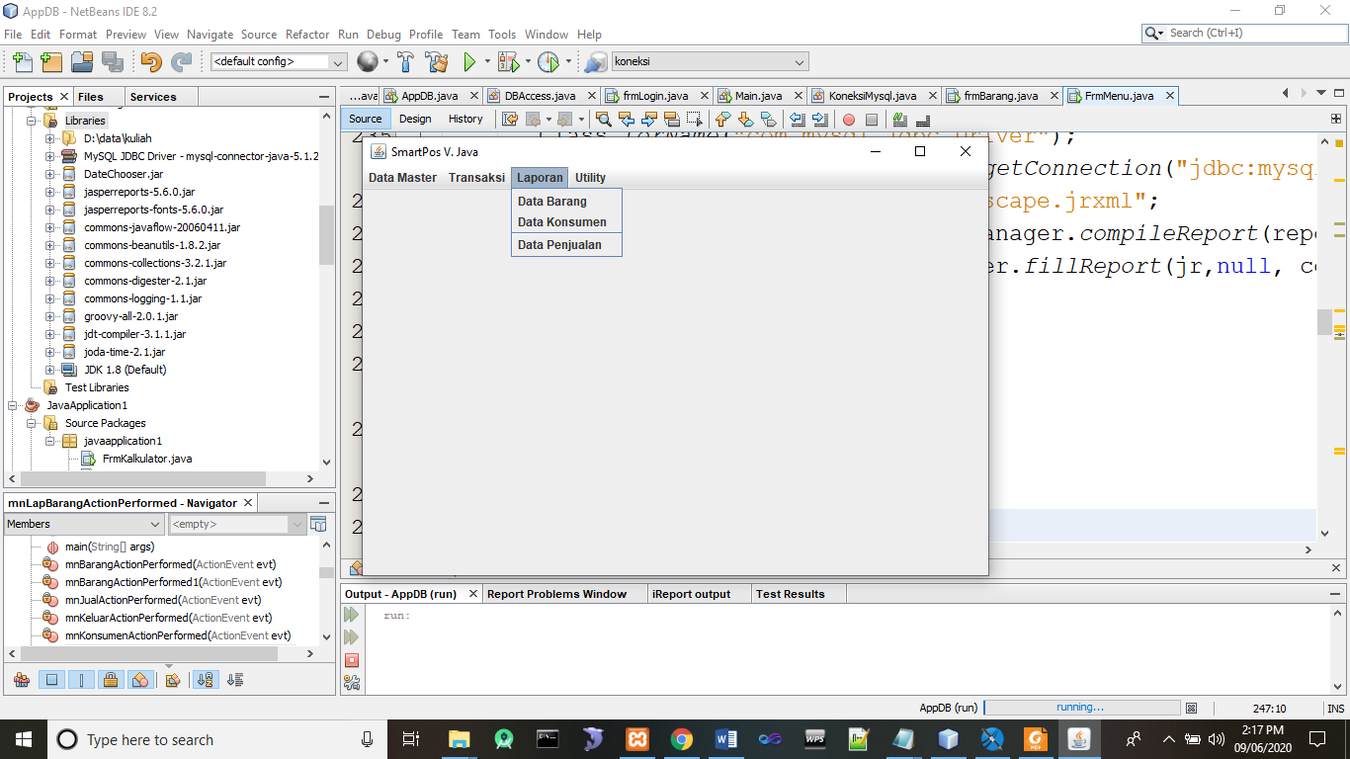
Memanggil Jasper Report di Java
Hasilnya

Slide 34
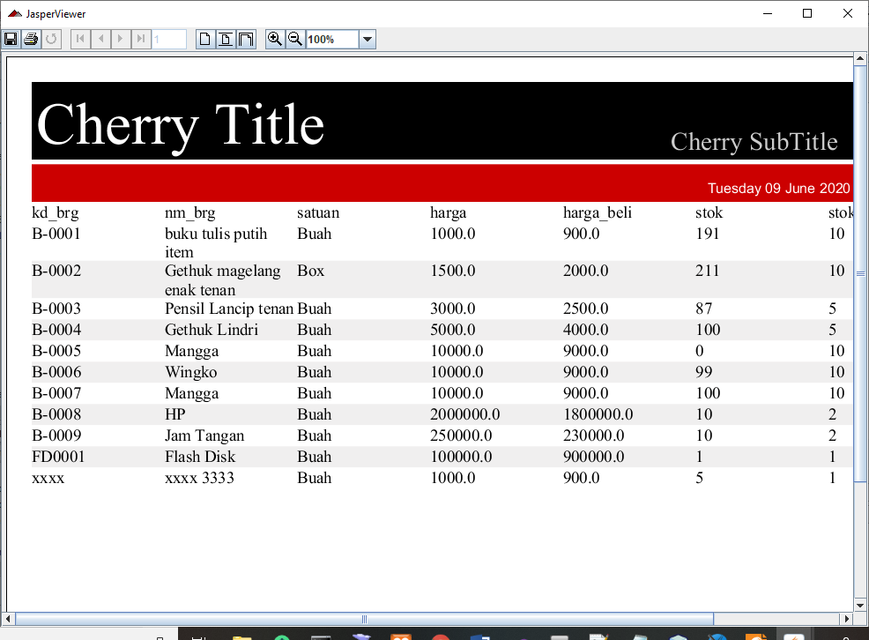
Memanggil Jasper Report di Java
Hasilnya

Slide 35
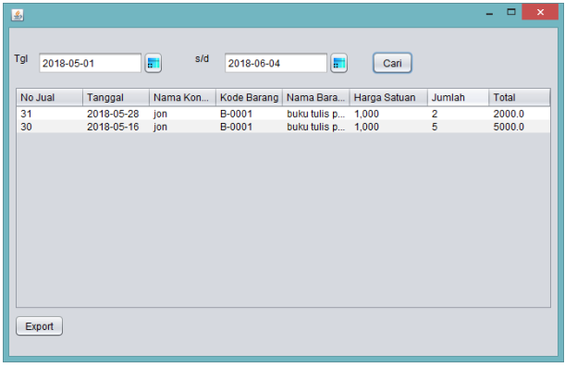
Laporan Export ke Excel
Buat Form

Slide 36
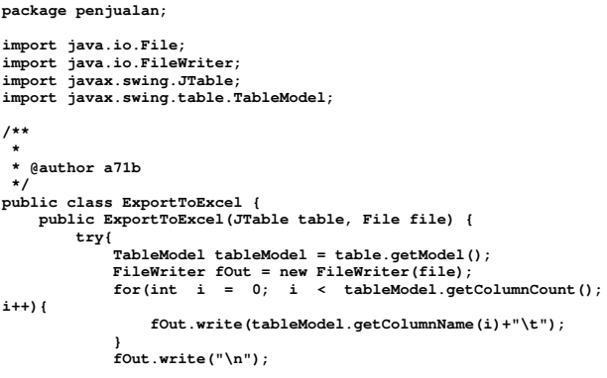
Laporan Export ke Excel
Code Class ExportToExcel

Slide 37
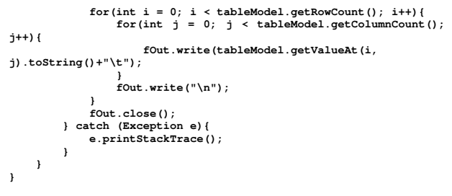
Laporan Export ke Excel
Code Class ExportToExcel

Slide 38
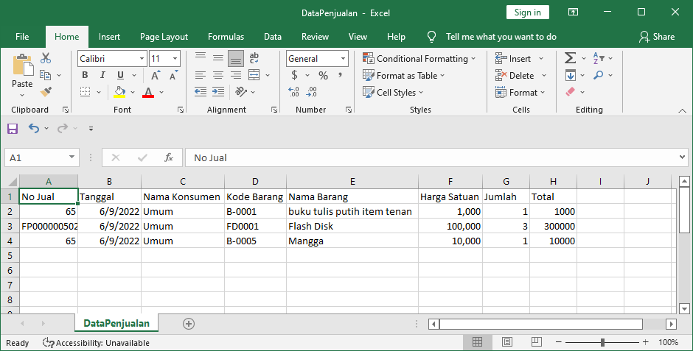
Laporan Export ke Excel
Membuat obyek Export ke Excel
ExportToExcel ex=new ExportToExcel(tblLapJual, new File("DataPenjualan.xls"));

Slide 39


Ajib Susanto
ajibsusanto@gmail.com
ajib.susanto@dsn.dinus.ac.id
http://ajibsusanto.net
@ajibsusanto / 085876247118

Slide 40
Referensi
Object First With Java, Fifth edition, David J. Barnes & Michael Kölling, Prentice Hall / Pearson Education, 2012.
The JavaTM Tutorial,
http://docs.oracle.com/javase/tutorial/java/nutsandbolts/, Oracle, 1995-2022.
Java SE Tutorial,
https://docs.oracle.com/javase/tutorial/ , Oracle, 2022.
Java Platform, SE Documentation,
https://docs.oracle.com/en/java/javase/index.html
Jaspersoft Studio, Jaspersotf Community, https://community.jaspersoft.com/project/jaspersoft-studio, 2022 .
Tutorial Jaspersoft Studio, Ajib Susanto, Udinus, 2020-2022

